Slide 1



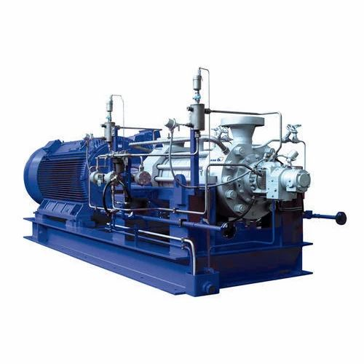


Annasaheb Dange College of Engineering & Technology, Ashta.
INTERNSHIP PRESENTATION
Mechanical Engineering Department
KSB Energy Pumps Division, Shirwal.
Internal- Institute Guide From The Institute: Prof. S. V. Nishandar And Prof. P.B. Patil
Prepared by :-
Shreyash Satish Killedar (19111005)
Department of Mechanical Engineering
31-03-2023
1

Slide 2





INDEX
About Company
Types of Pumps
What is Solar Energy ?
Calculation of Solar For 10HP motor
Battery System & Invertor System
Approx Budget Of Solar Project
Payback Period
Conclusion
Problem statement
Objectives
Literature survey
Expected outcomes
Proposed work
Plan of proposed work
Referances
31-03-2023
Department of Mechanical Engineering
2

Slide 3
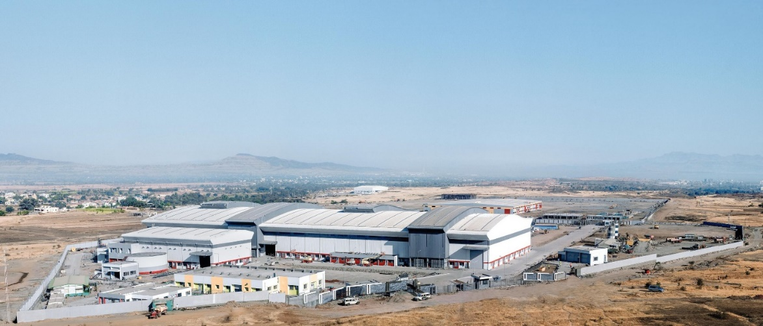
ABOUT COMPANY
The company was founded in 1872. Excellent products and first-class service - this is KSB in India. KSB Limited, specialises in Centrifugal Pumps & High Pressure Multistage Pumps. All the pumps and valves are offered to the market through a very wide distribution network. The company manufacturing the API & Non-API Pumps.
KSB Energy Pumps Division, Shirwal.
31-03-2023
Department of Mechanical Engineering
3

Slide 4
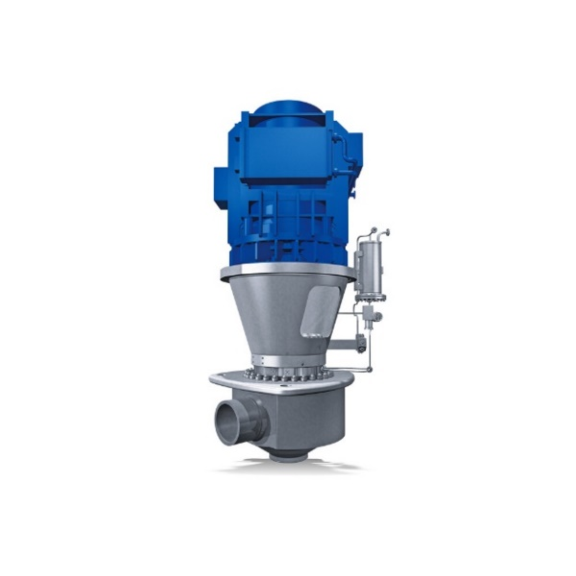
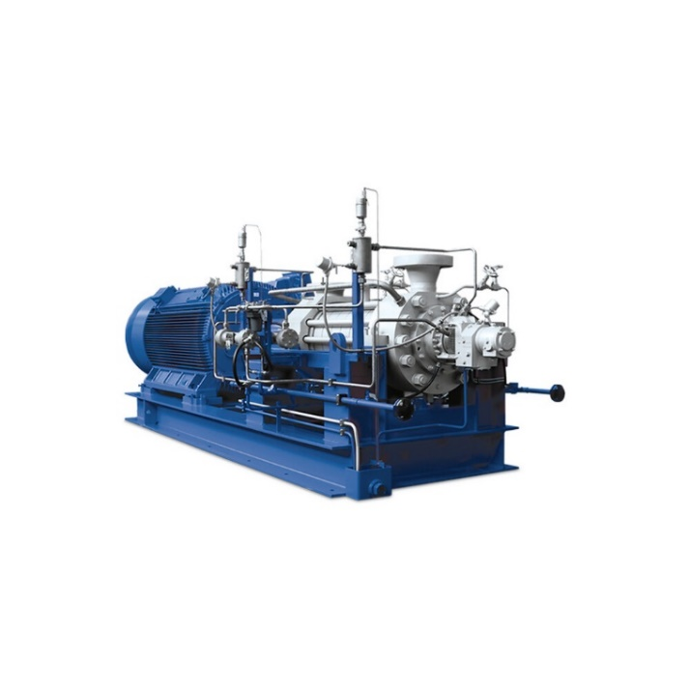
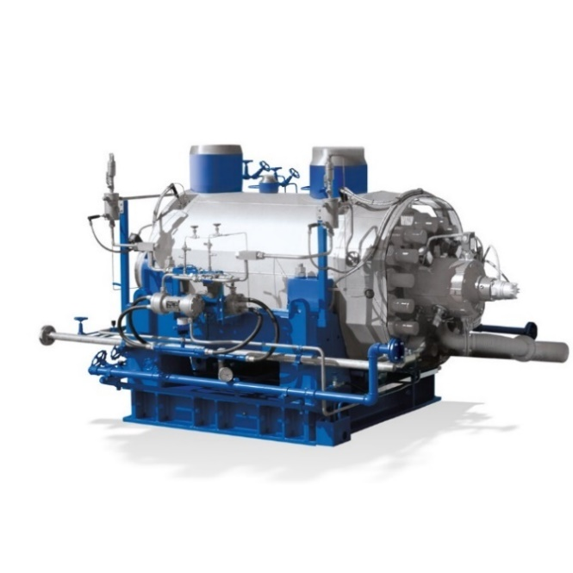
TYPES OF PUMPS
RSR Pump
HDA Pump
CHTR PUMP
Maximum Head: 215m
Maximum allowed fluid temperature: 350ºC
Minimum allowed fluid temperature: 5ºC
Minimum Head: 140m
Maximum Head: 4200m
Maximum allowed fluid temperature: 200ºC
Minimum Head: 0.1m
Maximum Head: 4000m
Maximum allowed fluid temperature: 200ºC
31-03-2023
Department of Mechanical Engineering
4

Slide 5
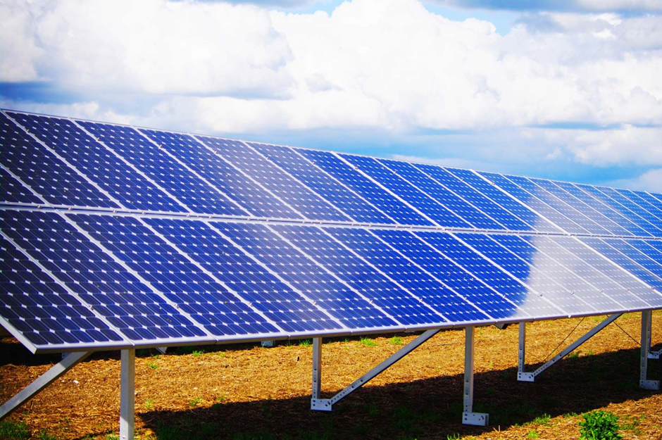
WHAT IS SOLAR ENERGY ?
The Solar Energy is the energy which is absorped from the sun and stored into the batteries.
There are various components are used in the solar panels such as aluminium frame, tempered glass, solar cells, junction box, etc.
The different solar panels had different efficiency of consuming solar energy.
31-03-2023
Department of Mechanical Engineering
5

Slide 6
Calculation of Solar For 10HP Motor
1) The Motor is Working for 4Hrs in 1 day. So the power required for 1 day is 7.5×4=30kwhr.
2) The Power Required for 1 month is,
30×30= 900kwhr
3) 1 Solar panel generates 300watts average power in 1 hr.
We have need of 7500w of power in 1 hr.
7500/300= 25 Solar Panels (Approx.) Required
4) So, 25 solar panels generates 7500kw energy in 1 hr
5) In normal days we absorb 3-4 hrs energy from sun.
Means 7500×4= 30000watts of energy collect from the sun per day and we use 15000watts of energy per day and other energy can be stored in the batteries.
6) Average Dimensions of Solar Panel is 2.2m×1.05m×0.035m
7) Monocrystalline Solar Panels are best solar panels because, it has highest efficiency than other solar panels.
31-03-2023
Department of Mechanical Engineering
6

Slide 7
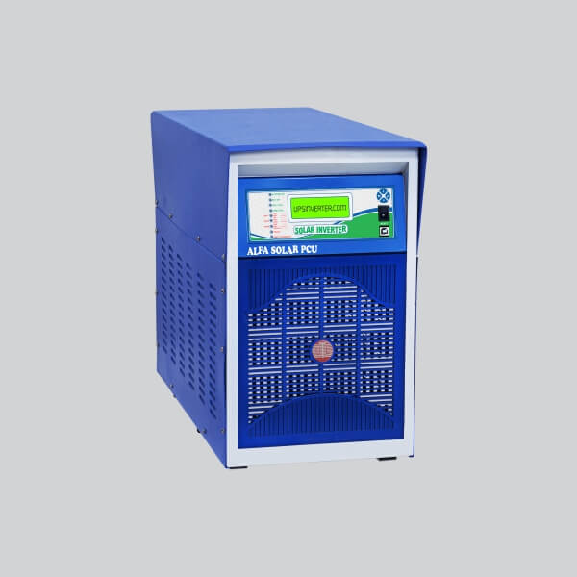
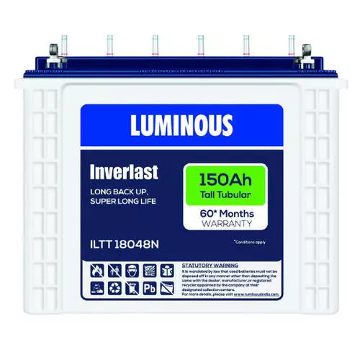
Battery System & Invertor System
1) One 150Ah battery can store 1600watts of average energy.
So we have required almost 10 batteries of 150AH .
2) The dimension of 1 Battery is 0.502m×0.191m×0.44m
3) Alfa + 10 KVA MPPT Solar PCU invertor can be required for 10Hp motor.
4) PCU is a Solar Power Conditioning Unit (PCU) which uses Solar energy (primary) and also the power from grid (secondary), to charge the batteries as well as to feed to connected load.
Inverter
Battery
31-03-2023
Department of Mechanical Engineering
7

Slide 8
Approx Budget Of Solar Project
1) Solar Panels
Average price of 1 solar panel is 15000rs (Bi-Ficial Solar Panels)
For 25 solar panels 13000×25= 325000Rs
2) Solar Panel GI structure (Galvanised Iron Structure)
For High Height 2500Rs
For Low Height 1500Rs
So Average Price for GI structure is 5000Rs for 7.5kw motor solar system.
3) Battery
Average price of 1 Battery of 150Ah is 12000Rs
For 10 Batteries 12000×10= 120000Rs
4) Invertor
Alfa + 10 KVA MPPT solar PCU
Price Of Invertor is 90000Rs
31-03-2023
Department of Mechanical Engineering
8

Slide 9
Approx Budget Of Solar Project
5) DC wires
6mm DC wire= Rs80/m & 10mm DC wire= Rs135/m
6) MC4 Connectors
Average 50Rs for 1 connector
2 in 1 out & 3 in 1 out
7) DCDB box & ACDB box
Used for the connecting the wires
DCDB box= 5000Rs & ACDB box= 3000Rs
8) LA & Earthing (For Safety from Thunderstorm)
1 LA (Lightning Arrestor) For 2000Rs
3 Earthing: 1 for Lightning Arrestor, 1 for Solar panel, 1 for Motor & Lights
9) Installation Cost
Average 20000Rs For installation.
31-03-2023
Department of Mechanical Engineering
9

Slide 10
Approx Budget Of Solar Project
Sr. No. | Components | Cost (in Rs.)
1 | Solar Panels | 325000
2 | Solar GI structure | 5000
3 | Battery | 120000
4 | Invertor | 90000
5 | All Accessories | 30000
6 | Installation | 20000
 | Total Cost (Approx.) | 590000
31-03-2023
Department of Mechanical Engineering
10

Slide 11
Payback Period
1) Electricity required for 1 month is 900kwhr.
So, Electricity bill for 1 month is 900×6= 5400Rs
And Electricity Bill For 1 Year is 5400×12= 64800Rs
2) Payback Period Of Solar System is,
Payback Period = Cost of Solar Panels / Electricity Savings Per Year
= 590000 / 64800
= 9 Years (Maximum)
31-03-2023
Department of Mechanical Engineering
11

Slide 12
Conclusion
The solar system has potentially high initial system cost, but it gives more benefit in long time.
When we installed solar system then there is low labour and maintenance costs.
No fuel requirement for solar project.
It can be easy to remove, transport, and store.
It has reliable and long life.
The solar systems are Non-polluting.
31-03-2023
Department of Mechanical Engineering
12

Slide 13


